Slide 1


P878-BANK ANALYTICS PROJECT
Group – 4
Abhishek Ranjan
Md. Samreen
Sejal Sahu
Pothuganti Ramya Sri
Darshini M.
Akshay Deo
PROJECT MENTORS
Shakeeb Qureshi
B. Harish

Slide 2

CONTENTS
Introduction
KPI’s List
Excel Dashboard
Tableau Dashboard
Power BI Dashboard
SQL Queries
Project Summary
/ Key Learnings

Slide 3

Introduction
PROJECT INTRODUCTION
This project focuses on analyzing the overall performance of loans disbursed by a bank across various segments including age, product, verification, and purpose.
We used Excel ,Power BI and Tableau to create an interactive dashboard that highlights key performance indicators such as funded amount, recoveries, interest rates, loan durations, and disbursement trends.
Data was derived from various dimensions such as:
Verification Status, Loan Duration, Religion, Grade, Product Type, Age Group, and Purpose Category.
The dashboard enables stakeholders to track total loans, high-performing segments, and disbursement patterns across years, helping with strategic decision-making and risk management.

Slide 4

KPI’S
Loan Portfolio KPIs
Total Loans Disbursed: 65,535
Total Revenue Generated: 2,417.10 Million
Total Collection Amount: 088.38 Million
Total Funded Amount: 732.70 Million
Total Interest Earned: 3.75 Million
Customer & Product KPIs
Top Age Group Loan Share: 26–35 years – 31.5% of total loans
Top Loan Product: XLG – 657 Million disbursed
Top Loan Purpose: Home Loans – 178 Million
3-Year Tenure Loan Share: 45,844 loans (70% of total)
Operational KPIs
Verified Loans Share: 19.5% (12,809 of 65,535)
Unverified/Others Status Loans: 42% (approx. 27,000+ loans)
Collection Efficiency Rate: 33.4% (808.38M / 2,417.10M)

Slide 5

EXCEL DASHBOARD

Slide 6
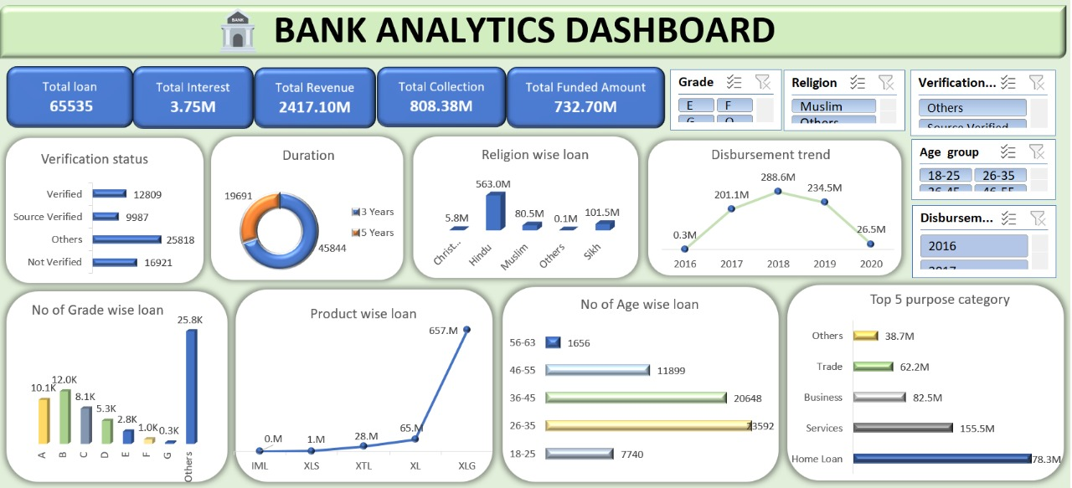

Slide 7

TABLEAU

Slide 8
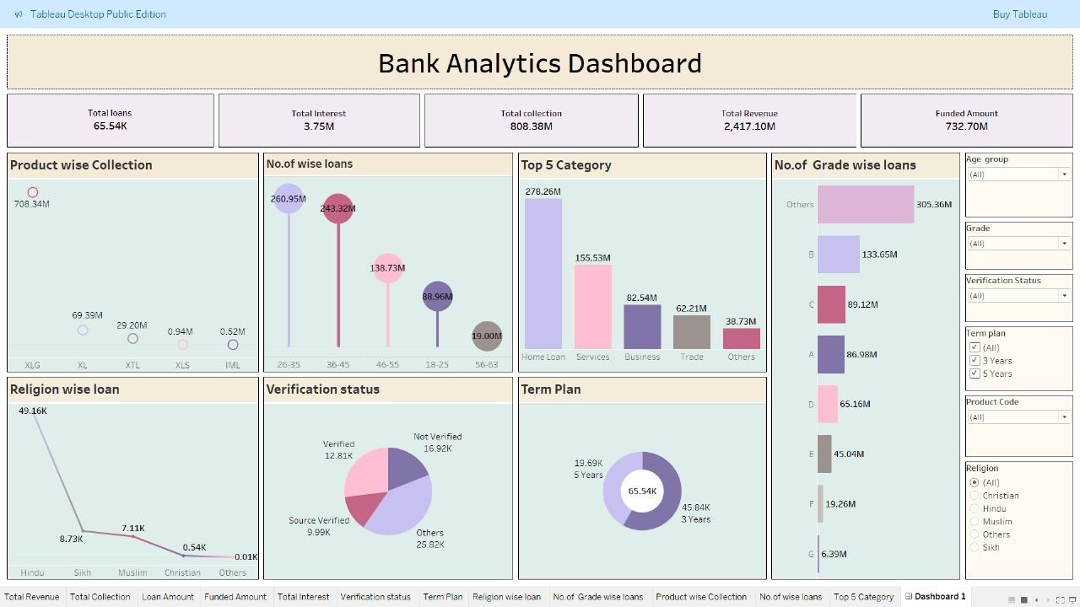

Slide 9

POWER BI

Slide 10
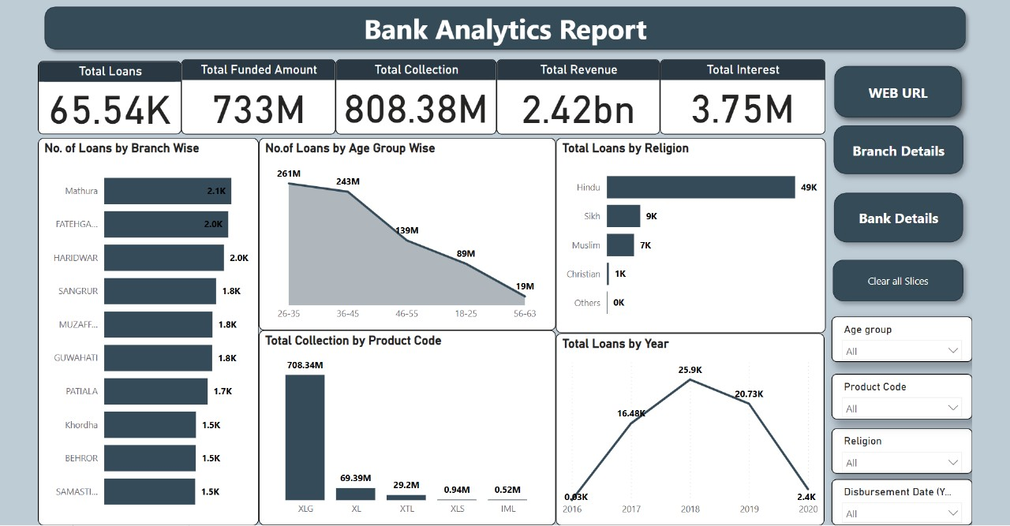

Slide 11
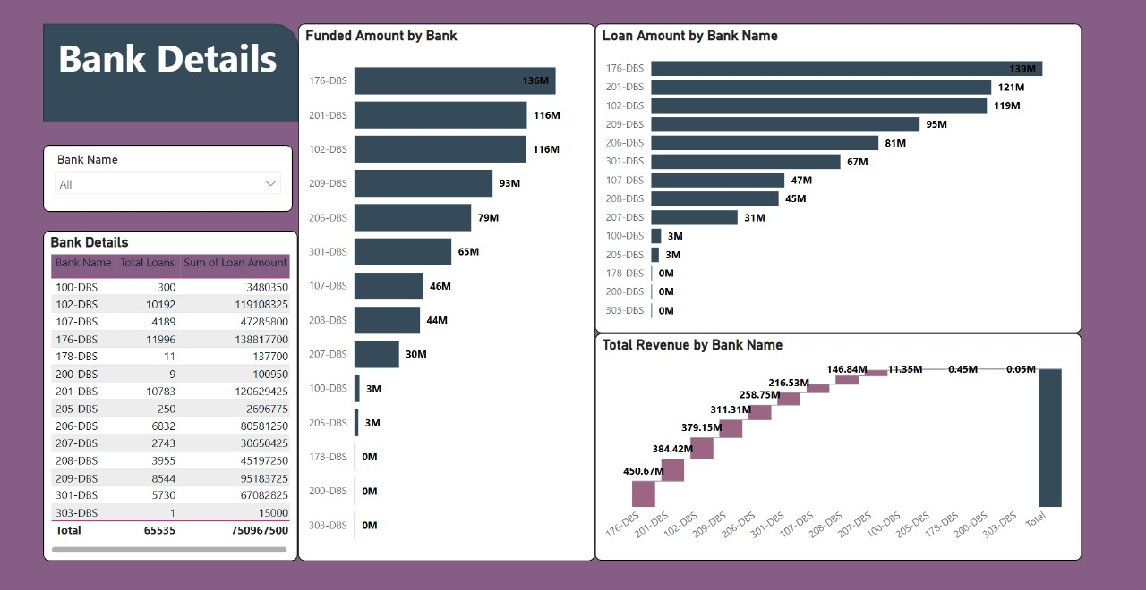

Slide 12
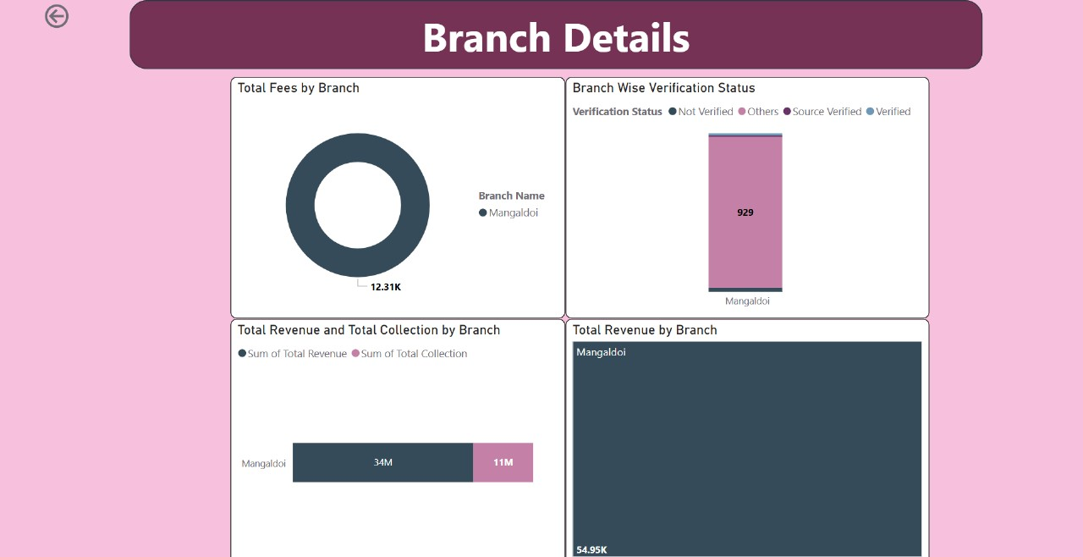

Slide 13

MYSQL
QUERIES

Slide 14
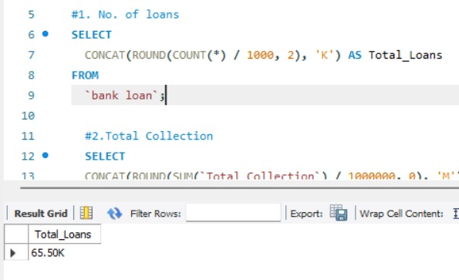
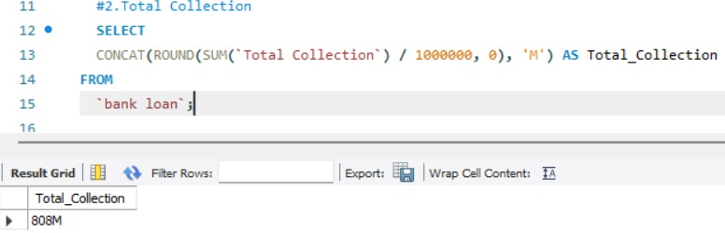
Total No. of Loans
QUERIES
Total Collection

Slide 15
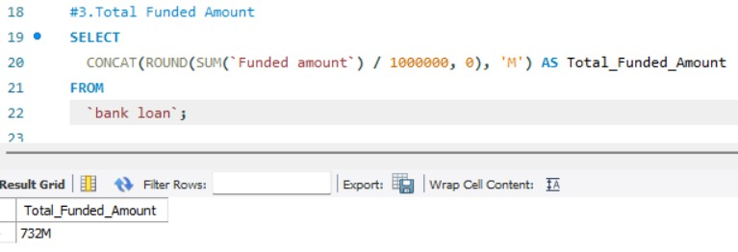
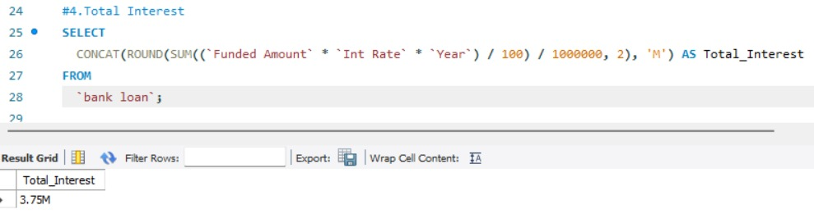
Total Funded Amount
QUERIES
Total Interest

Slide 16
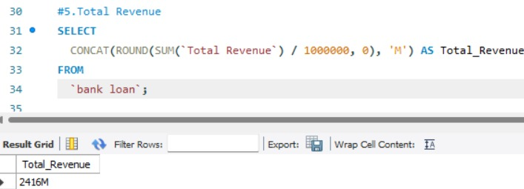
QUERIES
Total Revenue

Slide 17

CHALLENGES FACED DURING PROJECT
Issue: Excel became very slow or unresponsive while loading dataset.
Solution: Switched to Power Pivot / Power Query and minimized rows before loading.
Issue: Column names was incorrect
Solution: Renamed columns uniformly using Power Query to avoid errors.
Issue: Some rows had missing values
Solution: Replaced nulls and blanks according to the data types

Slide 18
PROJECT SUMMARY
Total Loans Disbursed: 65,535
Total Revenue: 2,417.10 Million
Total Collection: 808.38 Million
Total Funded Amount: 732.70 Million
Total Interest Earned: 3.75 Million---Key
Highest Loan Age Group: 26–35 years (20,648 loans)
Top Loan Product: XLG (657 Million disbursed)
Top Loan Purpose: Home Loan (178 Million), followed by Services (155.5 Million)Verification Status: 42% of loans fall under "Others" or "Not Verified" – indicating risk exposure
Loan Tenure Preference: Majority prefer 3-year loans (45,844 cases)
Disbursement Trend: Peaked in 2018 (289.6M), dropped sharply by 2020 (26.5M)
Religion-wise Distribution: Hindus dominate loan disbursements (563 Million), Muslims (80.5M), Sikhs (101.5M)

Slide 19
KEY LEARNINGS
1. Strengthen Verification and Risk Controls
Automate KYC and Verification to reduce the "Others" (25,818) and "Not Verified" (16,921) loan cases.
Enhance risk profiling using verification data to improve loan quality and reduce defaults.
2. Improve Disbursement Recovery
Revenue Collection (808.38M) is significantly lower than Total Revenue (2,417.10M).
Set up stronger collection strategies, such as automated reminders, flexible repayment plans, and customer education.
3. Reignite Growth Post-2018
Disbursement dropped sharply after 2018 – review policy or market factors that caused this decline.
Launch re-engagement campaigns and introduce seasonal offers to boost disbursements.

Slide 20


